Slide 1
E-commerce Journey
Andy && Theodore

Slide 2
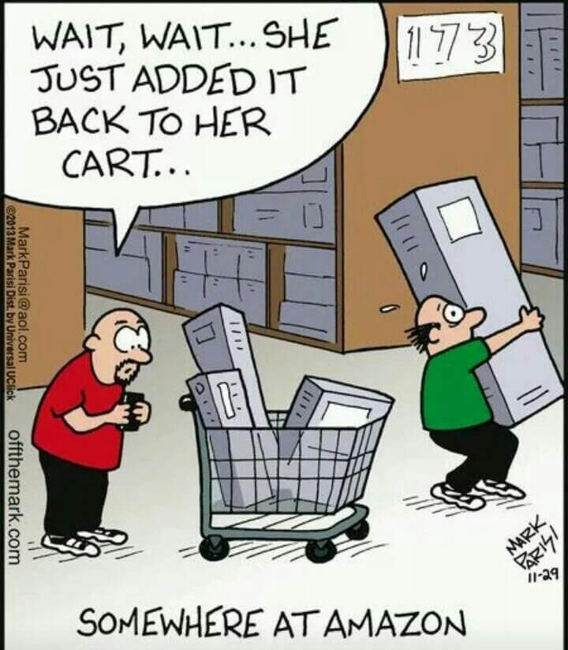
How not to yield to dynamics...

Slide 3
RoadMap
(keypoints)
Approach
Business logic
User Case
Take away

Slide 4

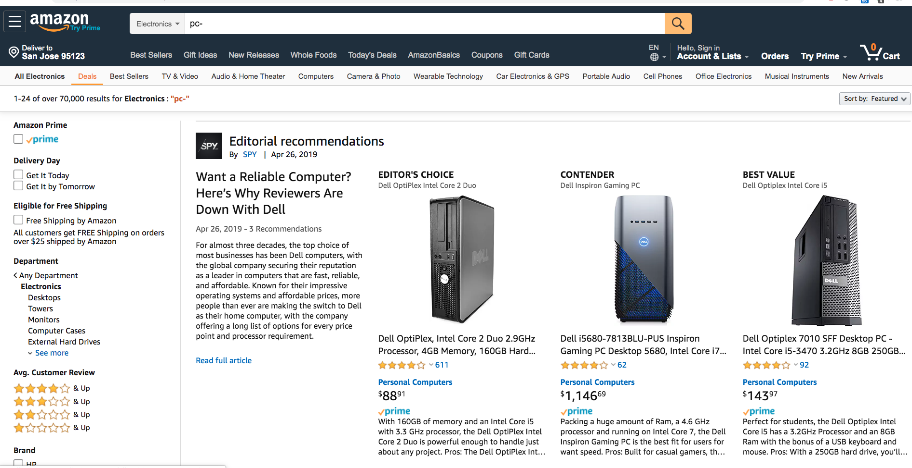
Insights: E-commerce in 90s vs today

Slide 5
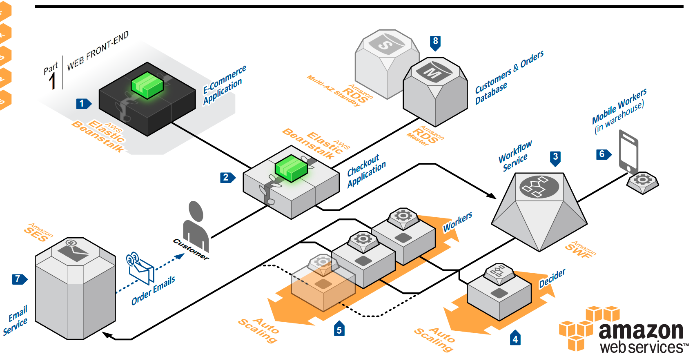
What hasn't changed.

Slide 6
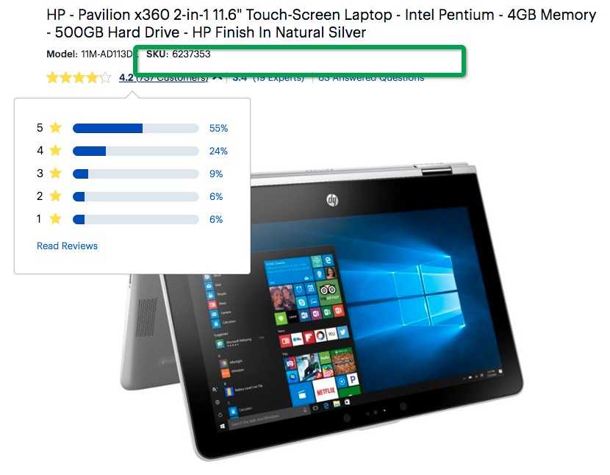
The Workflow step 1

Slide 7
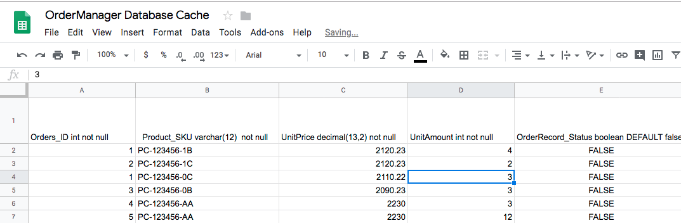
The Workflow step 2

Slide 8
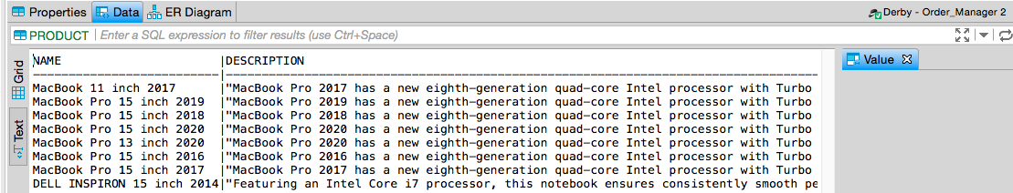
The Workflow step 3

Slide 9
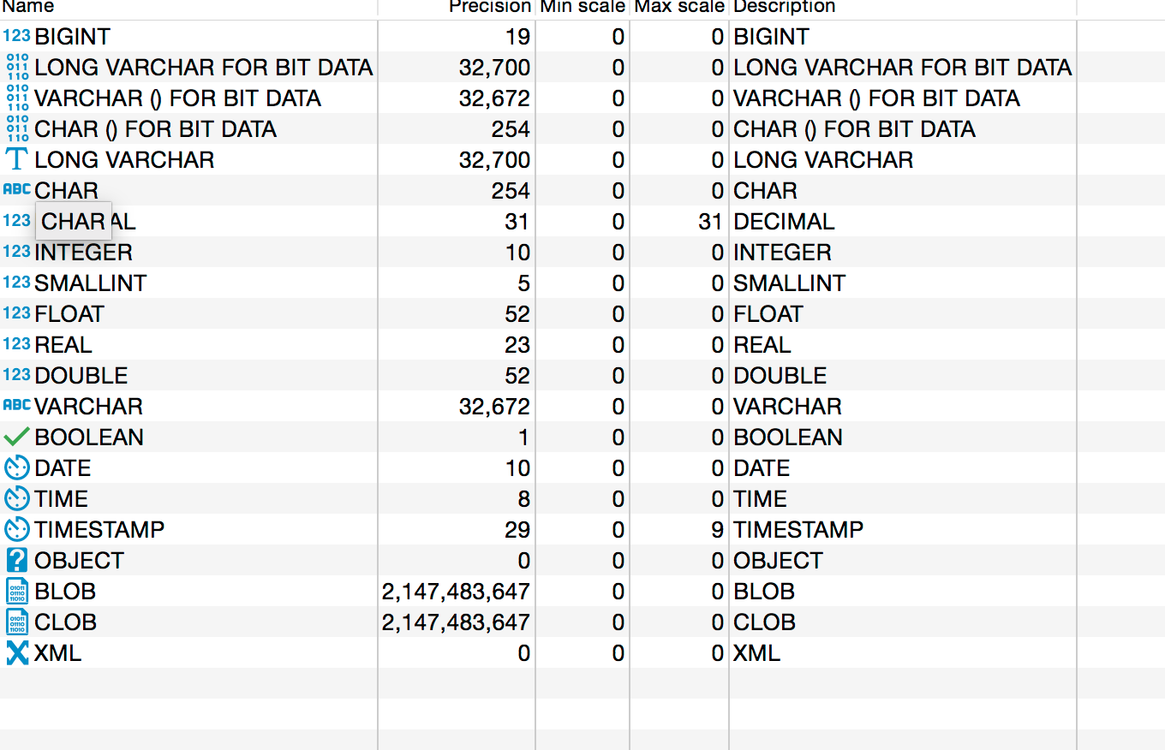
Configured-DataTypes

Slide 10
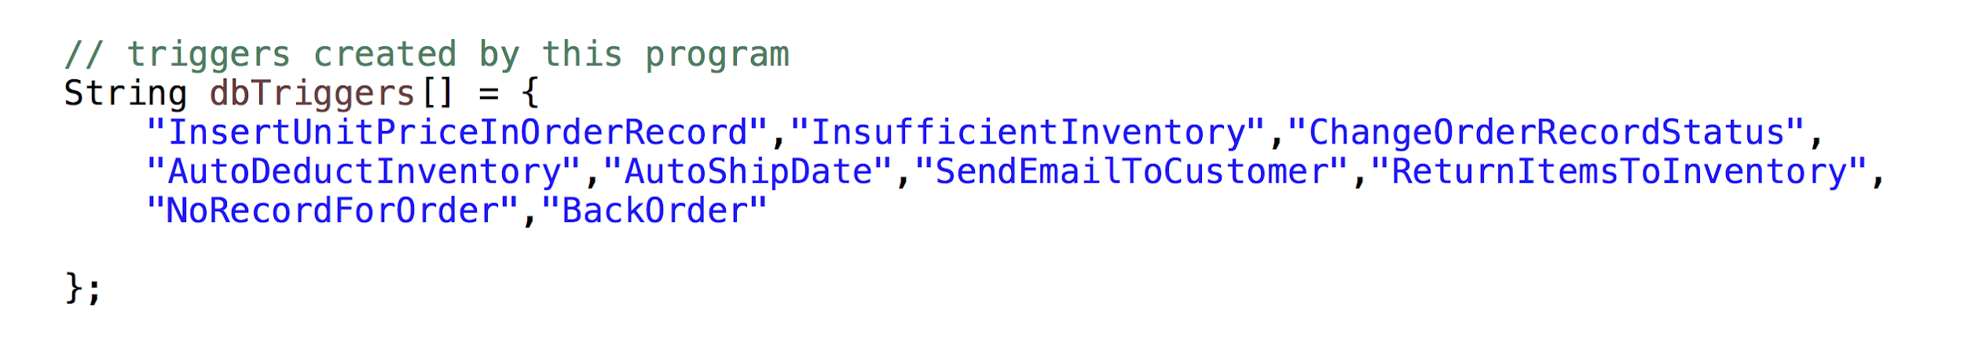
Implemented Function For Order Manager DataBase
Auto Order Date
Auto Ship Date
Support Replenish of Inventory
Support BackOrder
Multiple Triggers to achieve maximum automation

Slide 11
Key Design Choice
Primary Key in Product: SKU only ( not combined with UnitPrice or no Primary Key)
Orders has a field “Record Amounts” (Order 1 : 2 Records)
3. OrderRecord has a field Record_Status
False: not enough stock
True: enough stock, but not Shipped unless every Record
Under the same Order_ID has status true
4. If Available Units = 0 for SKU in Inventory Do not delete this
SKU - Replenish will check OrderRecord with status = false

Slide 12
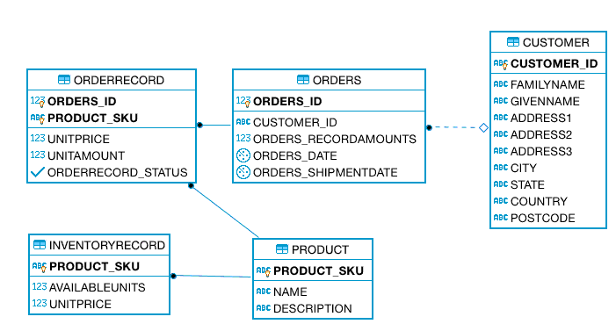
DDL - ER diagram

Slide 13
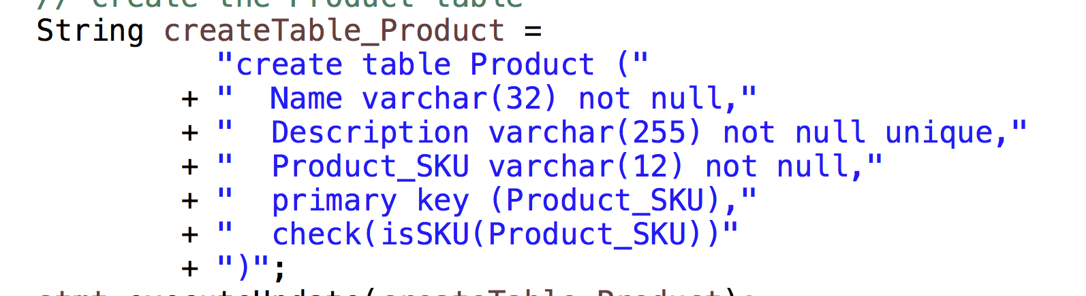
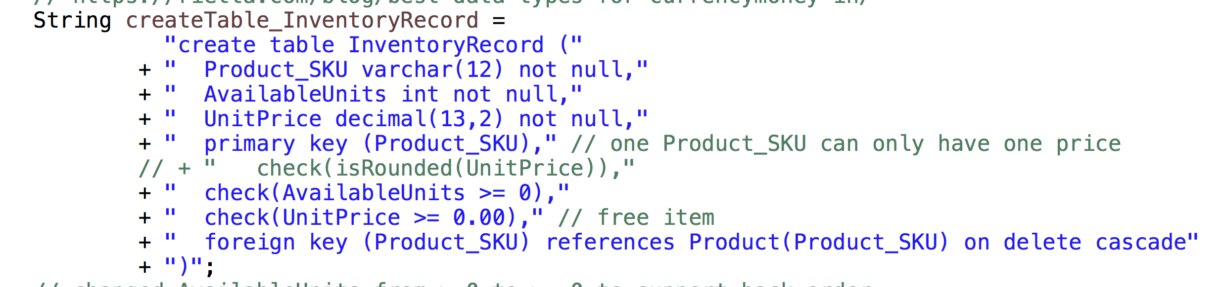
Unique / Decimal(13,2) / Free item / SKU with 0 stock
Adding On Update Restrict / On Update Cascade for mySQL only

Slide 14
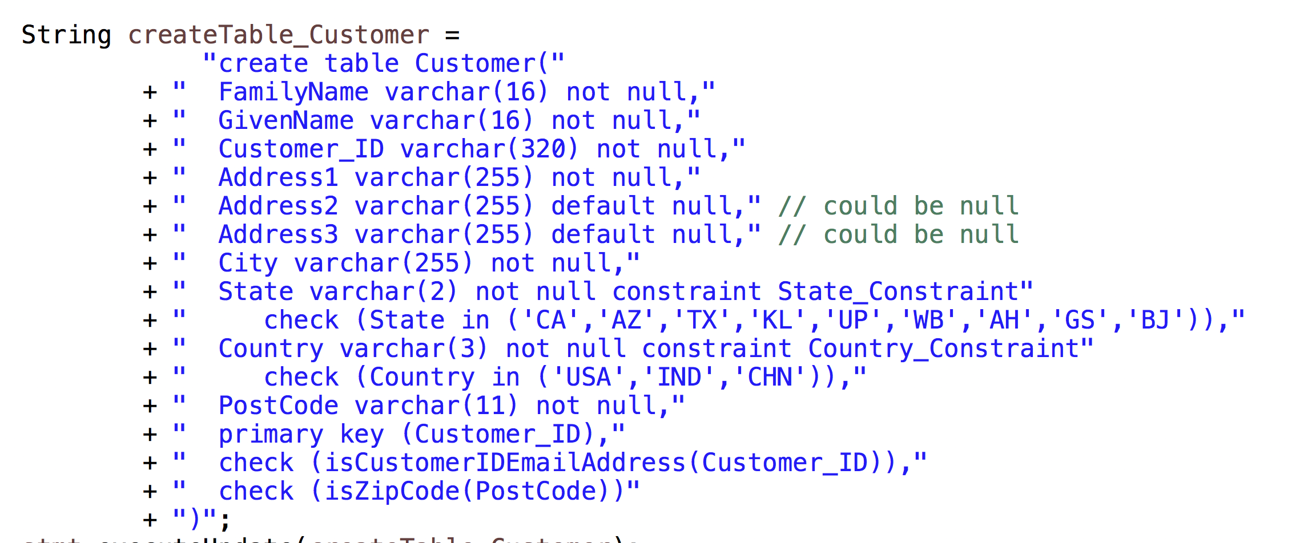
Enum / 3 Address subfields with 1 not null and 2 default null

Slide 15
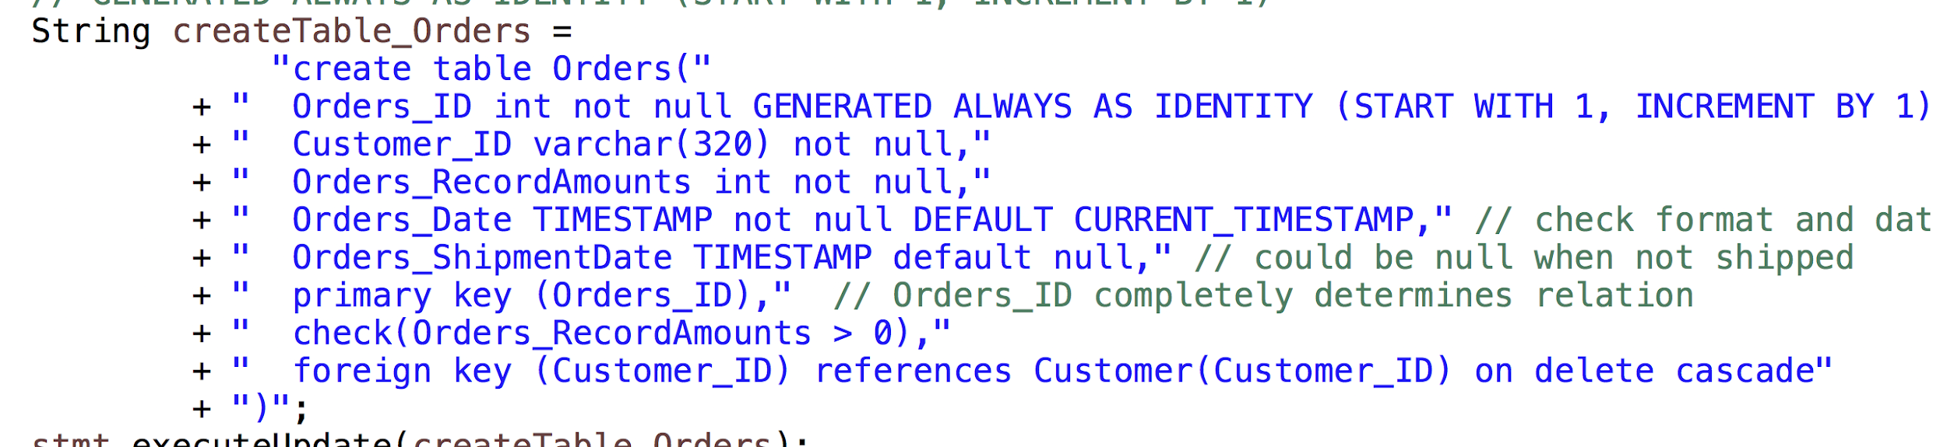
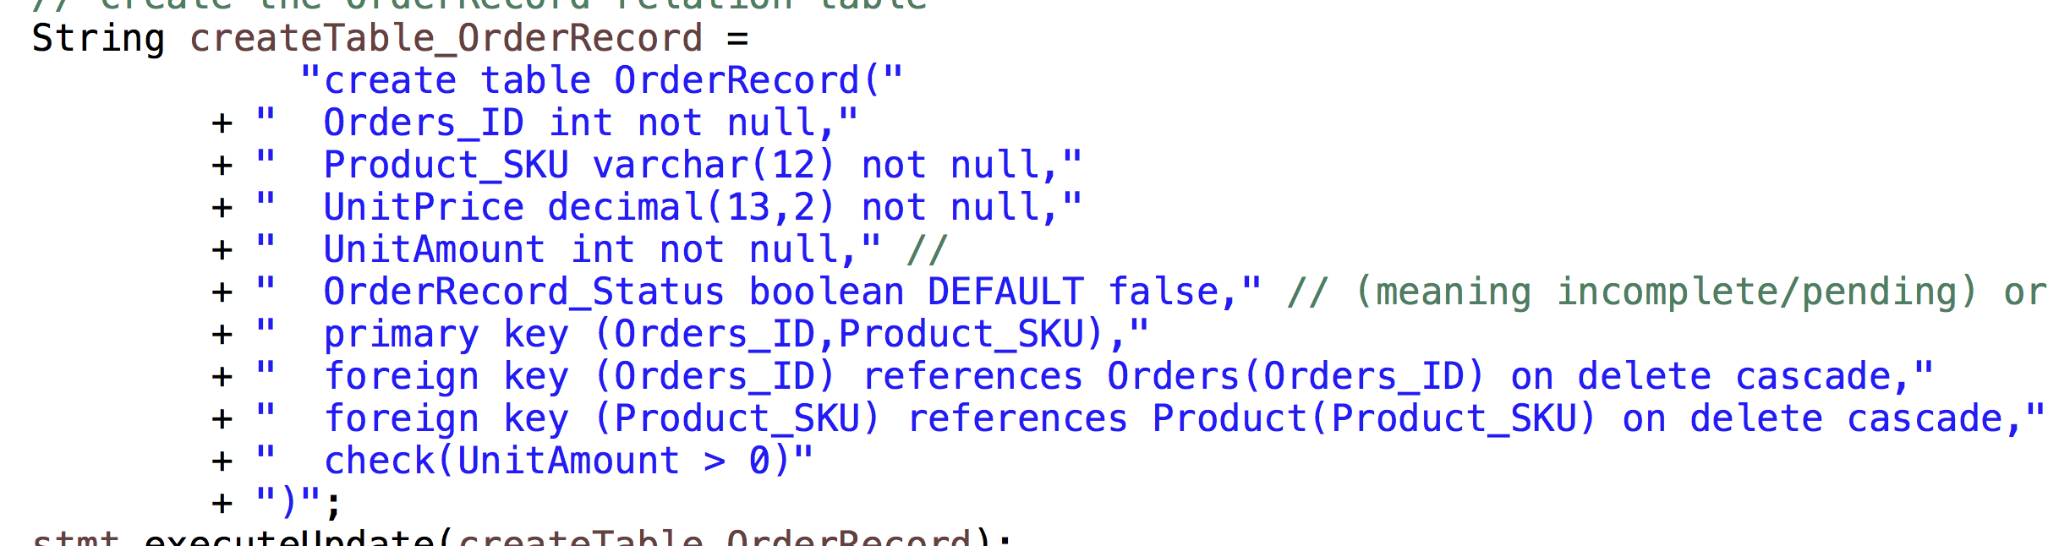
AUTO_INCREMENT / DEFAULT TimeStamp / DEFAULT value NULL for ShipDate

Slide 16
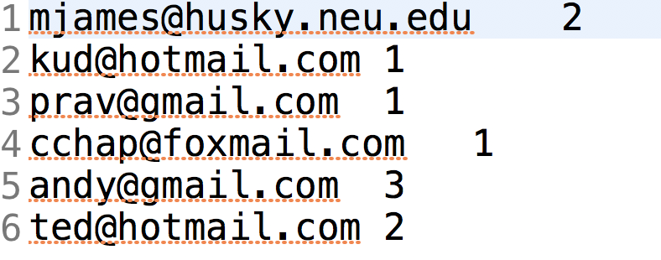
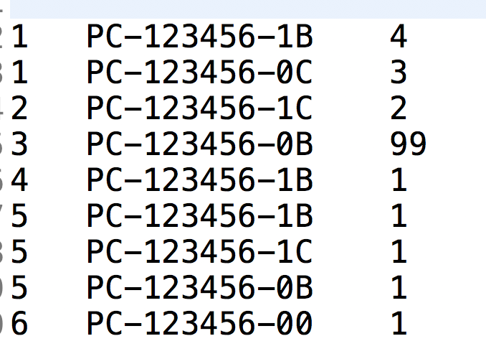
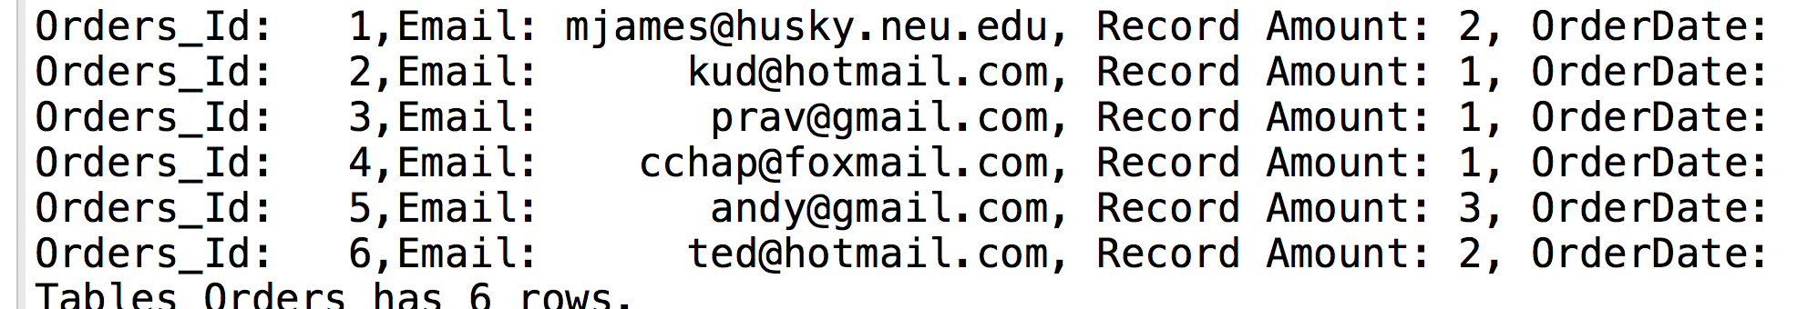
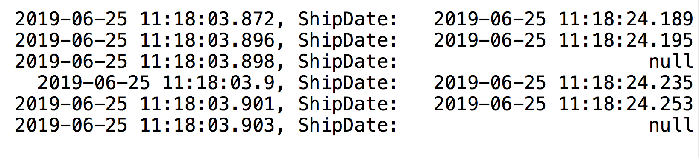
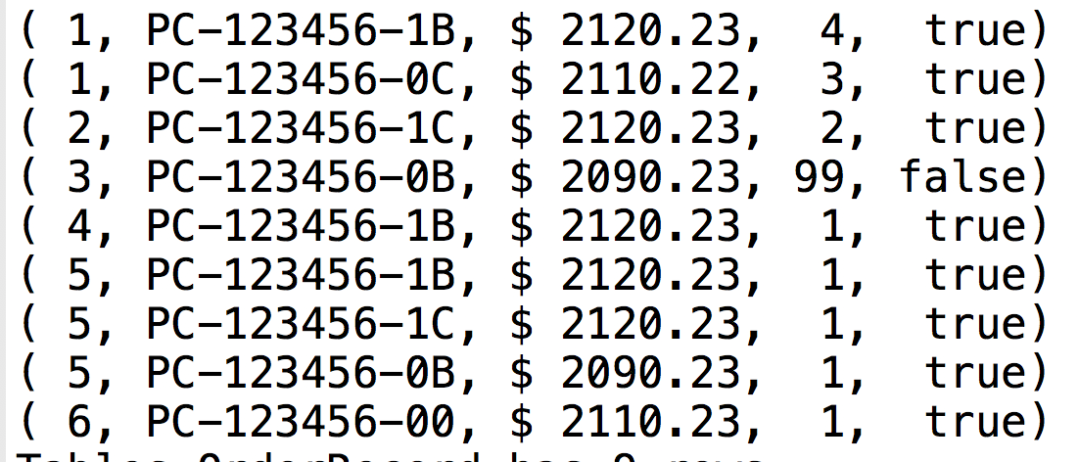
Cascading Triggers
Input Data for Orders
Input Data for OrderRecord

Slide 17
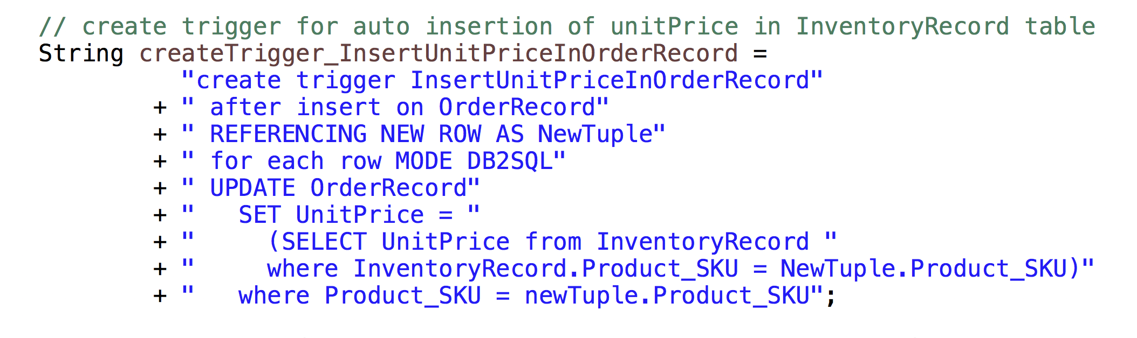
Cascading Triggers on OrderRecord
1. Auto Select Price for SKU from Inventory: Two Ways / Using Pure Trigger or Trigger Calling Stored Procedures

Slide 18
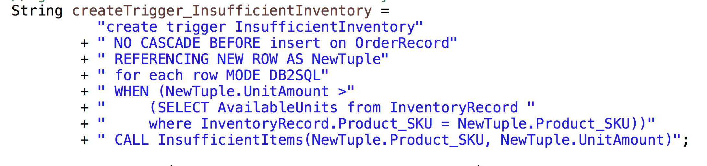
Cascading Triggers on OrderRecord
2. Check If Inventory Stock is not Sufficient, when = if check

Slide 19
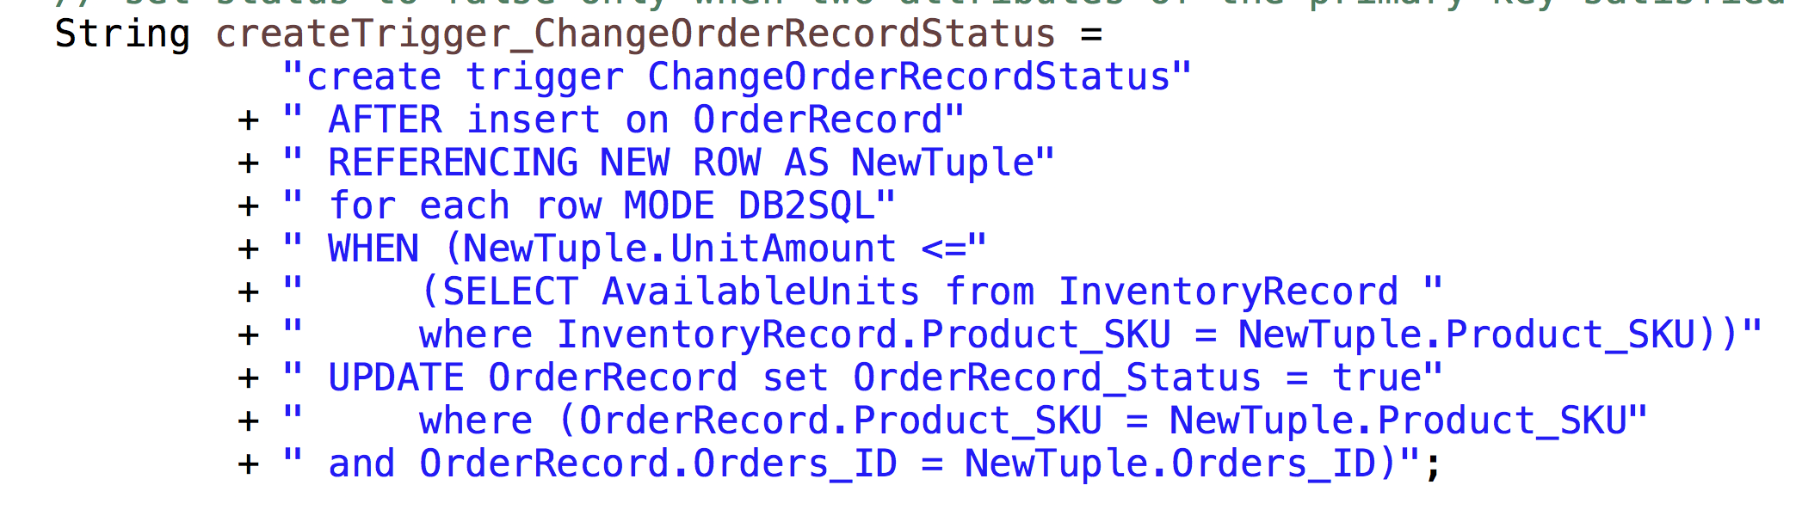
Cascading Triggers on OrderRecord
3. Check If Inventory Stock is Sufficient, the else branch after if because there is branching conditions check in Derby Trigger
Change status = True if enough stock, Change Trigger After Insert

Slide 20
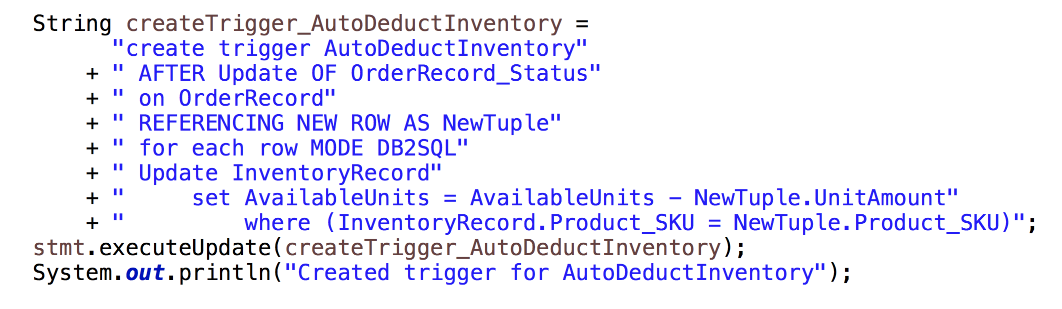
44
Cascading Triggers on OrderRecord
4. Trigger on change of the status, if true, then deduct the items from Inventory

Slide 21
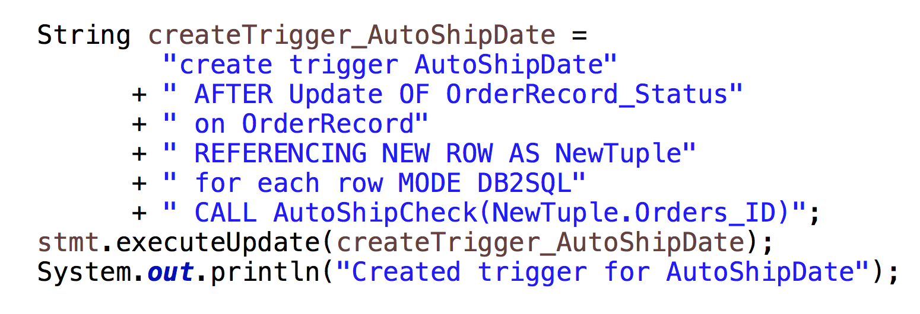
Cascading Triggers on OrderRecord
5. Yet another Trigger on change of the status, to check if the shipDate should be Set

Slide 22
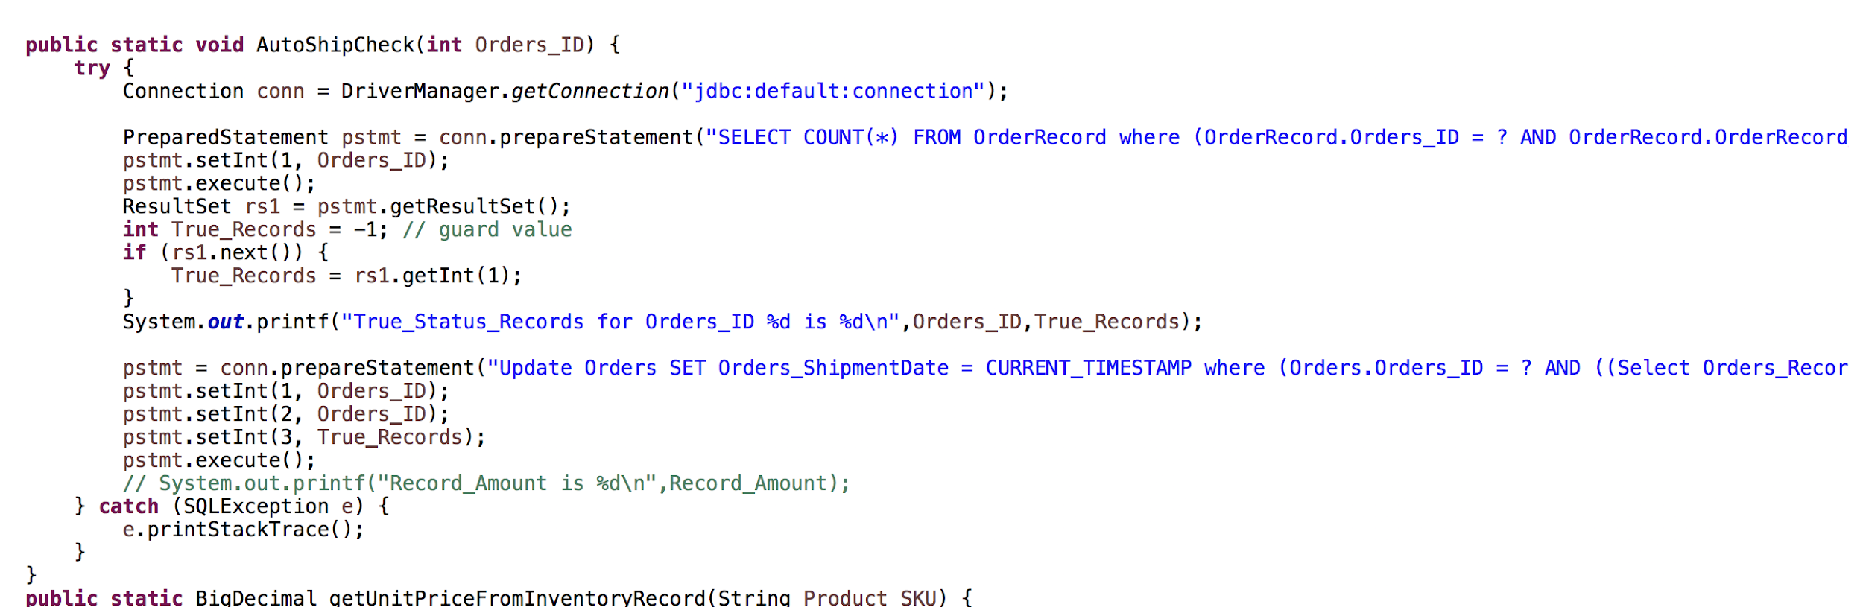
Cascading Triggers on OrderRecord

Slide 23
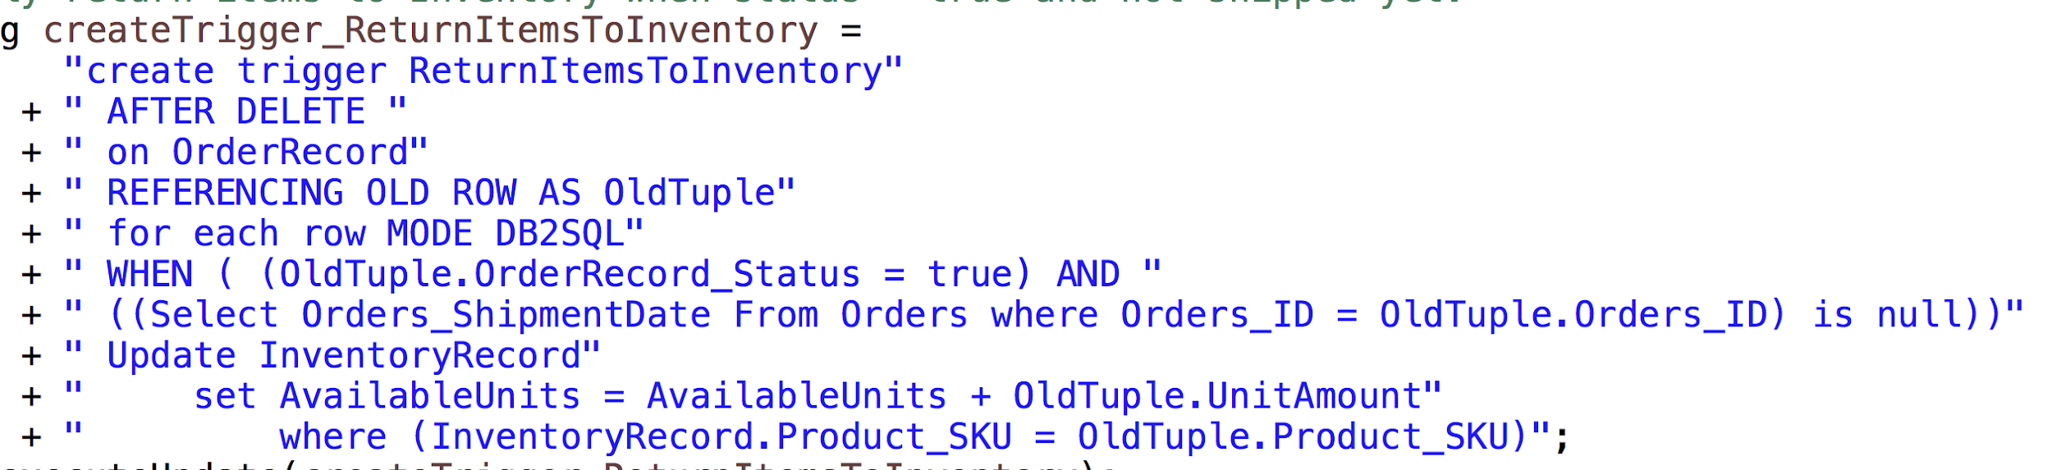
Functional Triggers
If Status = True, And No ShipDate yet (All records ship together), meaning there are other Records with False status
Delete record will return Items back to Inventory

Slide 24
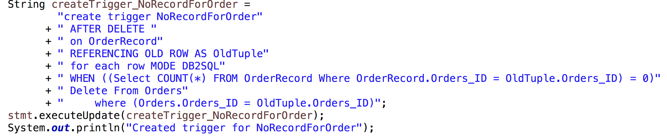
Functional Triggers
If this Record is the last Record for Order_ID ( regardless of status), then that Order_ID tuple is is deleted

Slide 25
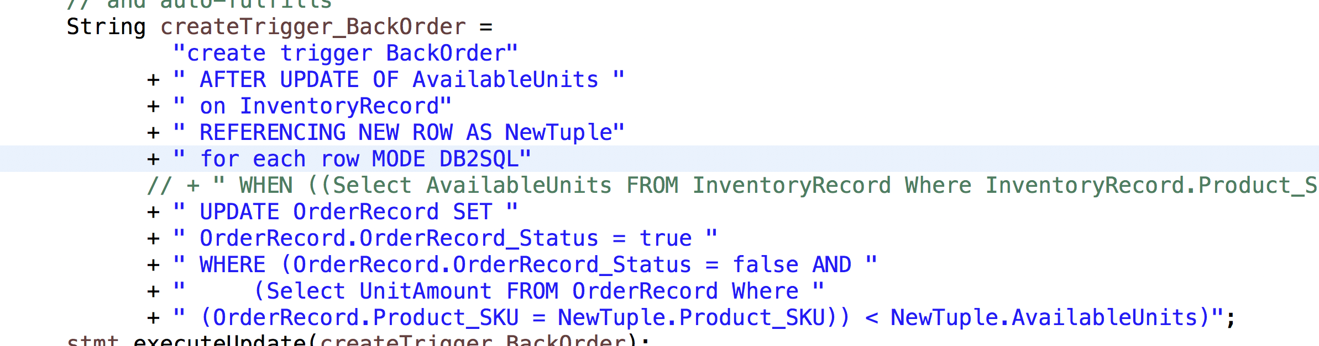
Functional Triggers
If Inventory is replenished, the check OrderRecord with status = false and that SKU, try to set the status = true
And set status = true will invoke cascading triggers (decrease stock, etc)

Slide 26
UseCases
{DQL}

Slide 27
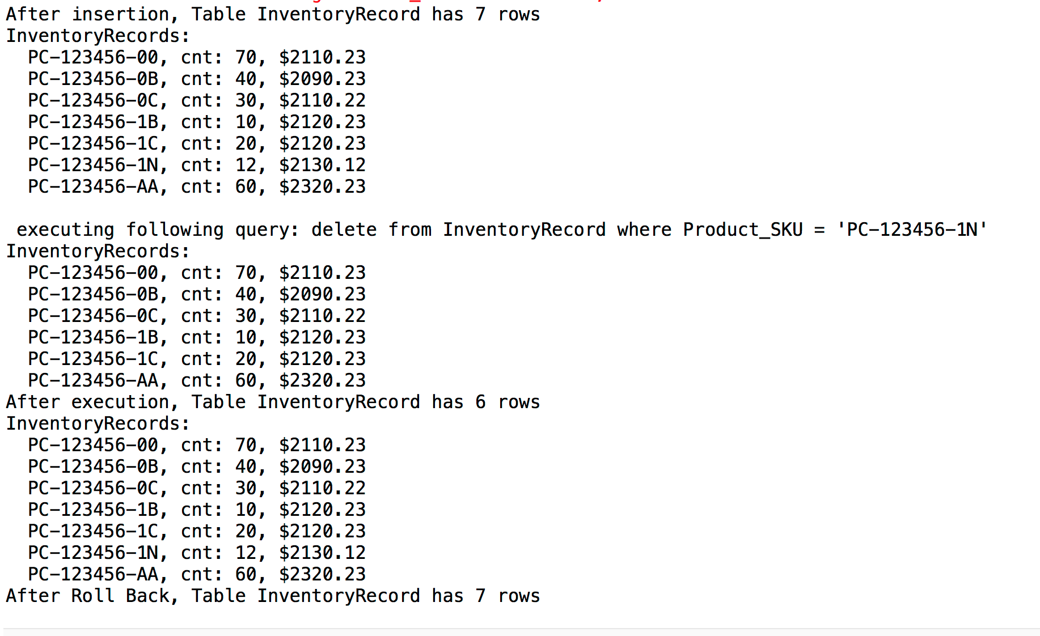
Transaction
Roll-back
*
API for insert/delete/update record and rollback
Notes:
30 sec

Slide 28
Know Thou Users
Lets run a demo ~
Notes:
2- min

Slide 29
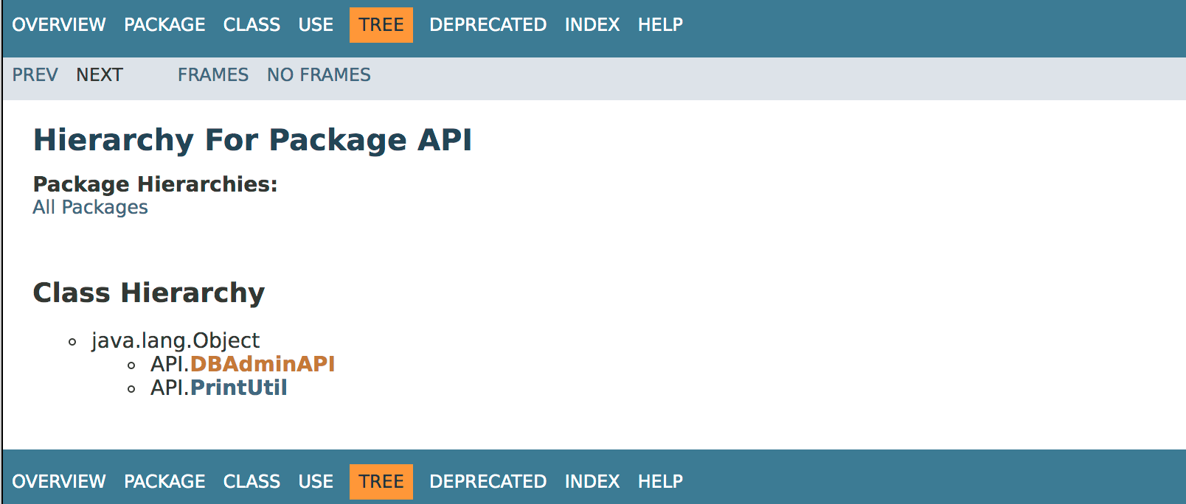
DQL Conclusion:
* API for Customer Orders system
* API for Data Analyst

Slide 30
Future Goal
* Automation (data loader sequentially)
* Encapsulations (apis -> RESTful apis)
* Scalability ( single user at time -> Concurrent users)

Slide 31
Future Goal
* Set the UnitPrice of OrderRecord to be Sale Price
1.Does not violate 3rd Normal Form
2.Meet Boyce–Codd Normal Form
3.Calculate Profit
Compare the efficieny by triggers and stored procedures

Slide 32
Reference
[1]. slides2 online seller's joke : https://www.kyozou.com/8-jokes-online-seller-will-love/
[2] slides 5 AWS https://aws.amazon.com/cn/blogs/aws/three-new-aws-reference-architectures-for-e-commerce/
[3] slides 6 Product sku & description https://www.bestbuy.com/site/hp-pavilion-x360-2-in-1-11-6-touch-screen-laptop-intel-pentium-4gb-memory-500gb-hard-drive-hp-finish-in-natural-silver/6237353.p?skuId=6237353

